Slide 1
Employee Data Analysis using Excel
STUDENT NAME: A.ATHILKSHMI
REGISTER NO: 312209266
DEPARTMENT: B.COM(General)
COLLEGE. : ANNA ADHARSH CLG FOR Women

Slide 2
PROJECT TITLE
Employee Performance Analysis using Excel

Slide 3


AGENDA
Problem Statement
Project Overview
End Users
Our Solution and Proposition
Dataset Description
Modelling Approach
Results and Discussion
Conclusion
3/21/2024 Annual Review

Slide 4

PROBLEM STATEMENT
The Employee Performance Analyzer is intended to evaluate an employee's current performance. When performance is low, the tool helps identify problem areas and offers strategies to enhance motivation and increase productivity.

Slide 5

PROJECT OVERVIEW
The project involves using Excel to evaluate employee performance data, concentrating on key metrics like productivity, efficiency, and goal achievement. The analysis will be presented in a PowerPoint, highlighting trends, strengths, and areas requiring improvement within the organization. Excel will be utilized for data organization, calculations, and creating visualizations such as charts and graphs to clearly convey insights.

Slide 6
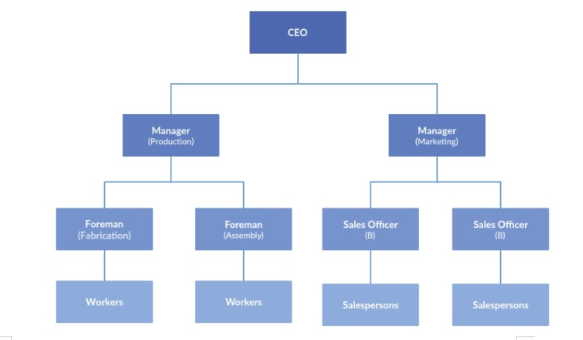

WHO ARE THE END USERS?

Slide 7

OUR SOLUTION AND ITS VALUE PROPOSITION
Using Conditional formatting : Missing figure Filter: Remove
Pivot: Summary
Graph: Data Visualization

Slide 8
Dataset Description
EMPLOYEE=KARGLE
26-FEATURES
9-FEATURES
EMPLOYEE ID-NUM NAME-TEXT
EMPLOYEE TYPE
PERFORMANCE SCORE
GENDER-Male,
FEMALE EMPLOYEE RATING -NUM

Slide 9

THE "WOW" IN OUR SOLUTION
PERFORMANCE=IFS(Z8>=5,”VERY HIGH”,Z8>=4,”HIGH”,Z8>=3,”MED”,TRUE”LOW”
3/21/2024 Annual Review
9

Slide 10
MODELLING
1.Data Collection:
a)Downloaded from the Edunet Dashboard.
b)Gathered the employee performance score
2.Feature Collection:
a)Identified performance levels.
b)Removed blank columns.
3.Performance Levels:
a)Determined performance scores using formulas.
b)Defined them using a pivot table.
4.Summary:
a)Downloaded the employee dataset from the dashboard and deleted blank columns.
b)Created performance levels using formulas.
c)Defined them with a pivot table.
10

Slide 11
RESULTS
11

Slide 12
conclusion
The employee dataset, as analyzed by me using Excel, shows that the organization is performing well overall. While most employees exhibit good performance, a few need improvement. To help them develop, additional tasks can be assigned. This conclusion highlights the key findings from the dataset.

